Slide 1
ADO.NET PROJECT
BY
MOHD TALHA
POOJA PATIL
PRATHYUSHA ANUMULA

Slide 2

Table of contents
CREATION OF TABLES
FORM 1(INSERTION OF EMPLOYEE TABLE)
FORM 1(INSERTION OF DEPARTMENT TABLE)
SEARCH FORM
UPDATE FORM
DELETE

Slide 3
CREATE TABLES FOR EMPLOYEE,DEPARTMENT
→ Columns for EMPLOYEE table →Columns for DEPARTMENT table
* EMPID *DEPTID
*EMPNAME *DEPTNAME
*DOB *DEPTLOCATION
*PHONE *MANAGERID
*EMAIL
*SALARY
*DEPTID

Slide 4
→Inserted values to the tables
→created Buttons to the Form to Search the data from tables.
→created Update button in the form to update the data in the tables .
→Created Delete button in the form to delete the data in the tables.
→Created Insert button in the form to insert the values to the required table.

Slide 5
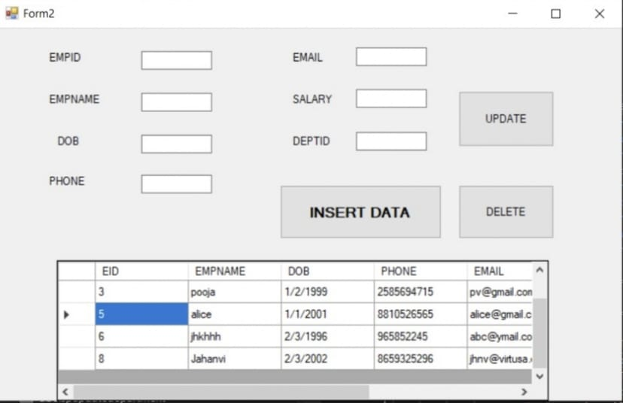
Form 1(insertion of empLOYEE table)

Slide 6
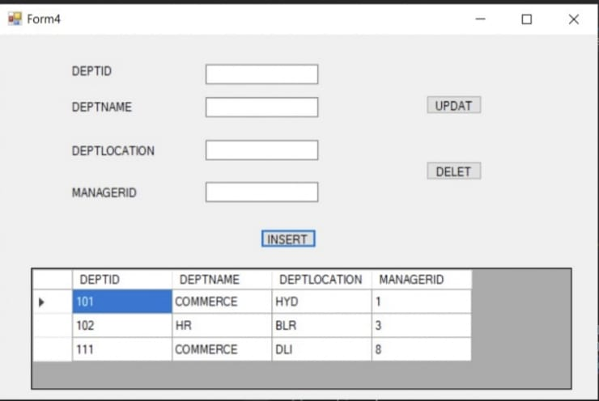
Insertion table for department

Slide 7
Search form by prathyusha
Drag two labels named it as EMPNAME and SALARY , two textboxes and Search button and a Datagridview to display the data.
We get the record according to the data given to the empname and salary textboxes.

Slide 8
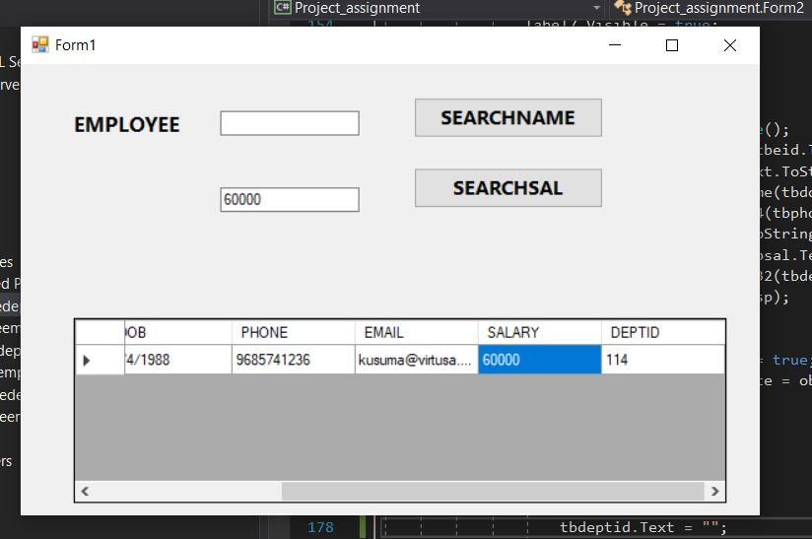
If we want to get the details of employee whose salary is 60000 we need to enter salary then click on searchsal we get the output employee

Slide 9
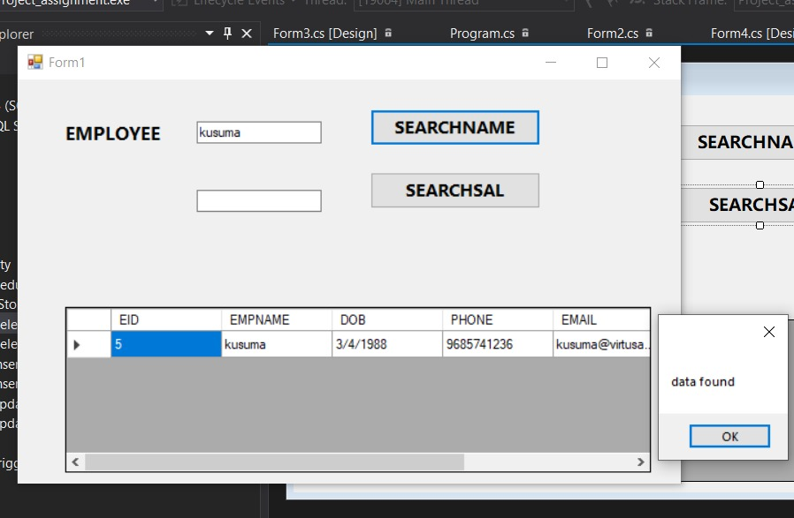
We can search the employee details according to the name. enter name of the employee and then click on searchname so that we will get the details of particular employee

Slide 10
Inserting data to the table
Inserted values using stored procedure.
Created stored procedure for Employee table
create procedure spinsertemployee
@eid int, @ename varchar(50), @dob date, @phone bigint, @email varchar(50),
@sal float, @deptid int
as
begin
insert into employee values(@eid,@ename,@dob,@phone,@email,@sal,@deptid)
end

Slide 11
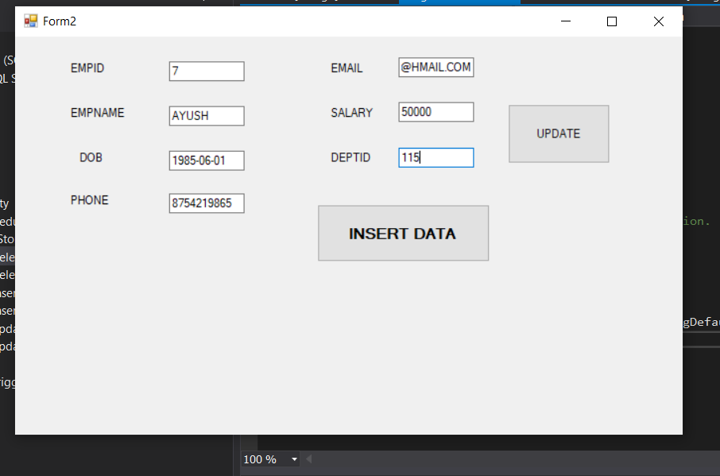
Entered the values to the form

Slide 12
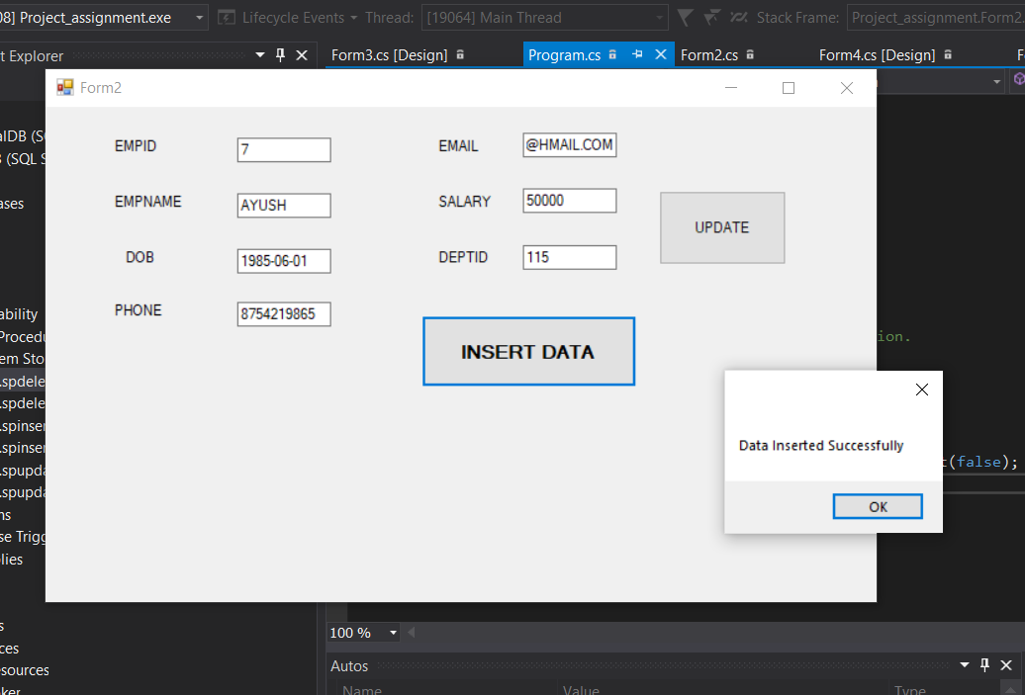
Click on insertdata button then we will get a message box showing “Data inserted successfully”

Slide 13
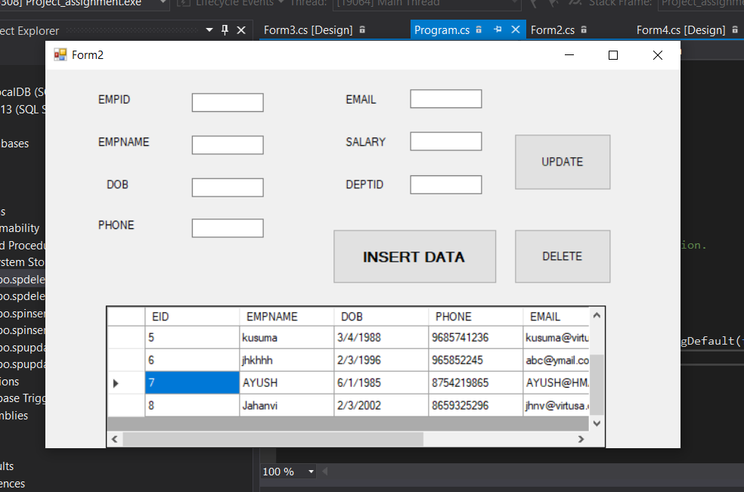
Finally we get the data into the employee table

Slide 14
Created stored procedure for deparment table
create procedure spinsertdeparment
@deptid int, @deptname varchar(50), @deptlocation varchar(50),@managerid ini
as
begin
insert into department values(@deptid,@deptname,@deptlocation,@managerid)
end

Slide 15
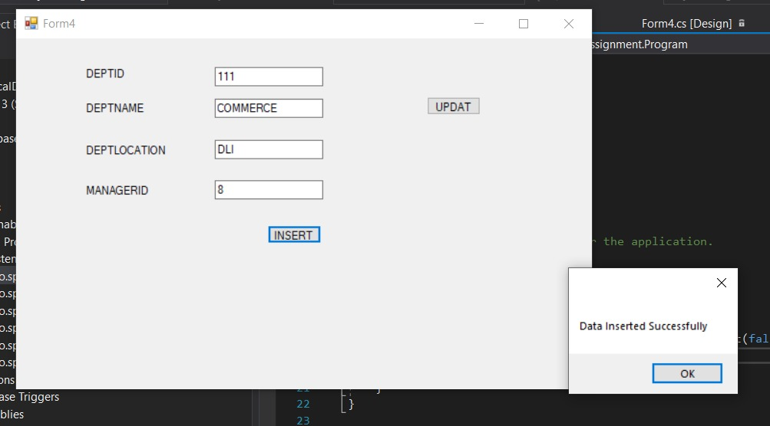
Enter the values, Click on insertdata button then we will get a message box showing “Data inserted successfully”

Slide 16
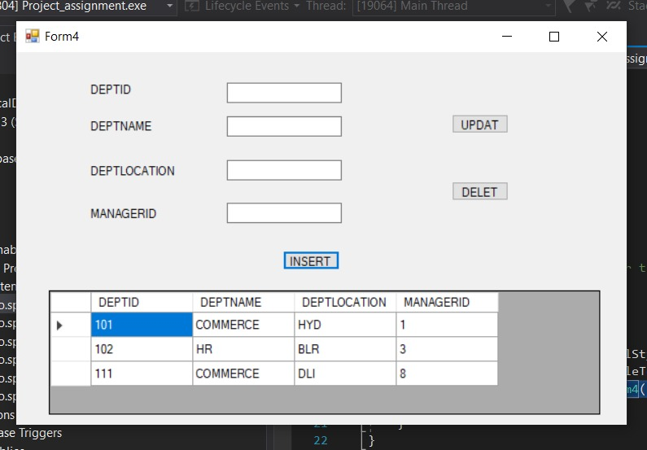
Finally we get the data into the employee table

Slide 17
Update form CREATED by pooja
Drag labels named it as EMPID,EMPNAME,DOB,PHONE,EMAIL,SALARY,DEPTID
and seven textboxes and Update button and a Datagridview to display the data.
We get the record according to the data given to the EMPID,EMPNAME, DOB,PHONE,EMAIL,SALARY,DEPTID Textboxes

Slide 18
UPDATING data to the table
Updated values using stored procedure.
create proc spupdateemployee
(@EMPID INT,@EMPNAME VARCHAR(50),@DOB DATE,@PHONE BIGINT,@EMAIL VARCHAR(50),@SALARY FLOAT,@DEPTID INT)
AS
BEGIN
UPDATE EMPLOYEE SET EMPNAME=@EMPNAME, DOB=@DOB,PHONE=@PHONE, EMAIL=@EMAIL, SALARY=@SALARY, DEPTID=@DEPTID WHERE EMPID=@EMPID;
END

Slide 19
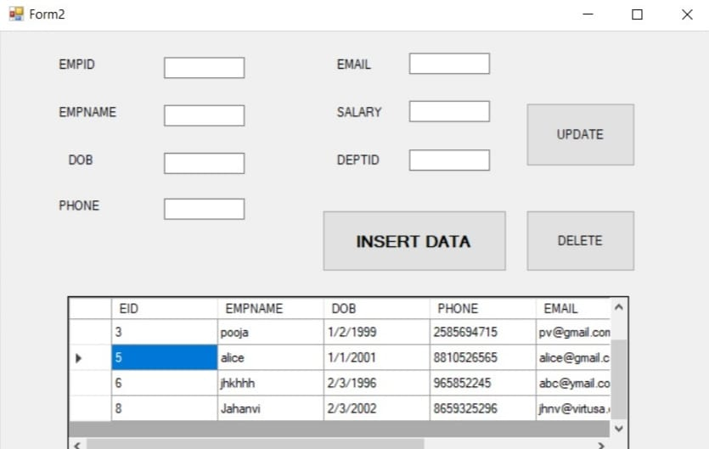
Form before updating the data

Slide 20
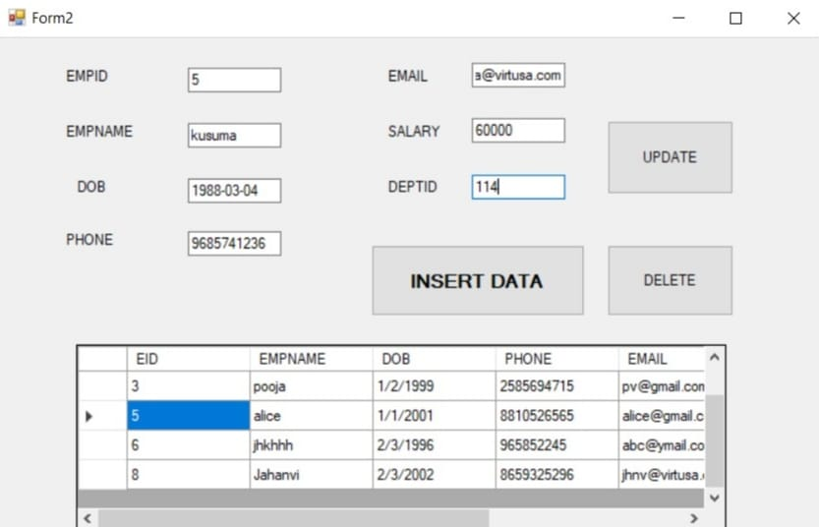
inserted value to the form to be updated

Slide 21
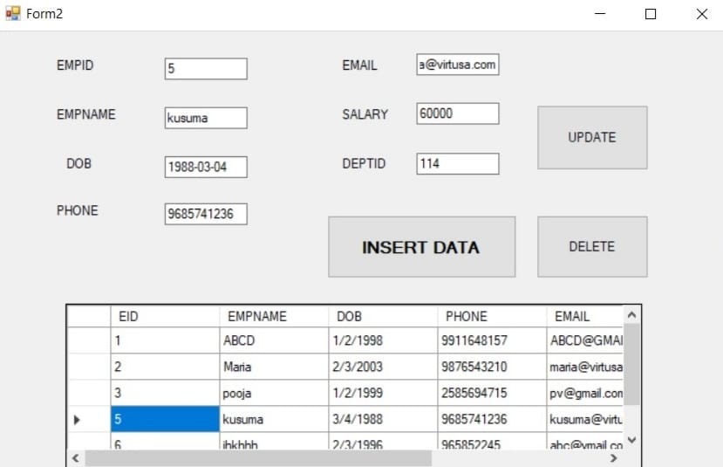
Click on update button then we can see data UPDATED in the employee table

Slide 22
Created stored procedure for department table
create proc spupdatedepartment
(@DEPTID INT, @DEPTNAME VARCHAR(50), @DEPTLOC VARCHAR(50), @MGRID INT)
AS
BEGIN
UPDATE DEPARTMENT SET DEPTNAME=@DEPTNAME, DEPTLOCATION=@DEPTLOC, MANAGERID=@MGRID WHERE DEPTID=@DEPTID
END

Slide 23
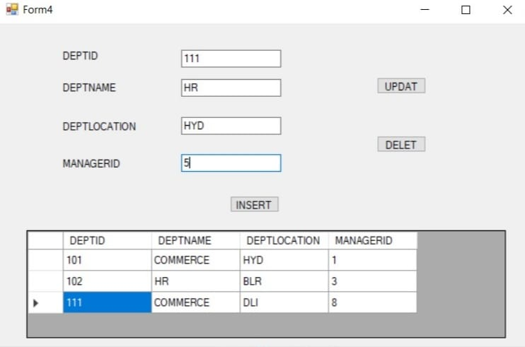
Inserted data to be updated click on the update button then data get updated in employee table

Slide 24
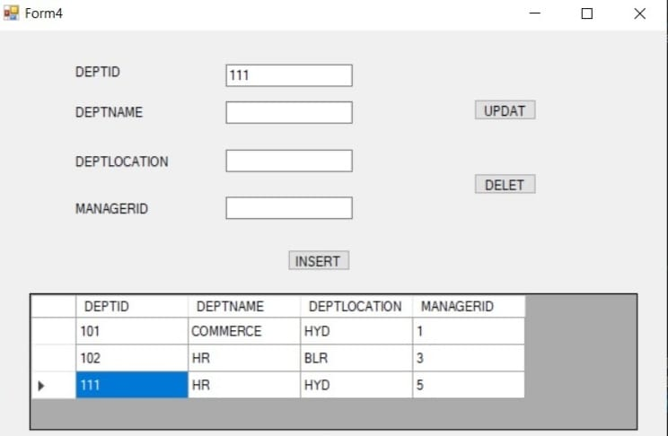
Updated data in department table

Slide 25
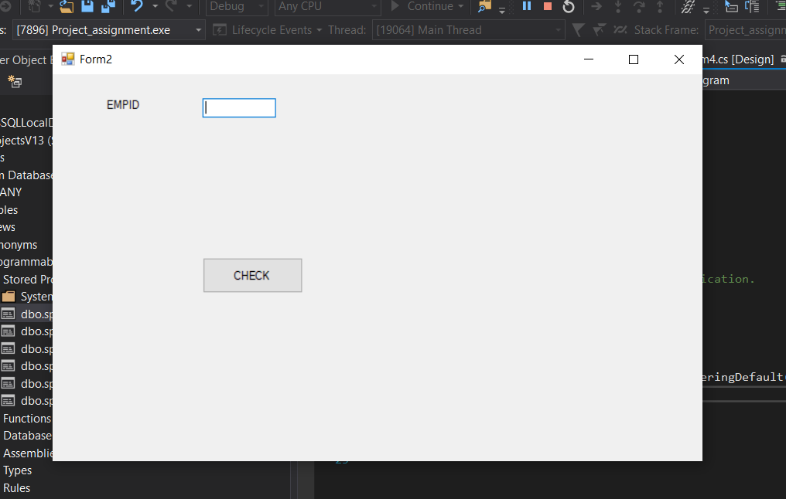
Work done by mohd talha
Check button for checking if data available in the table with given employee ID or not.

Slide 26
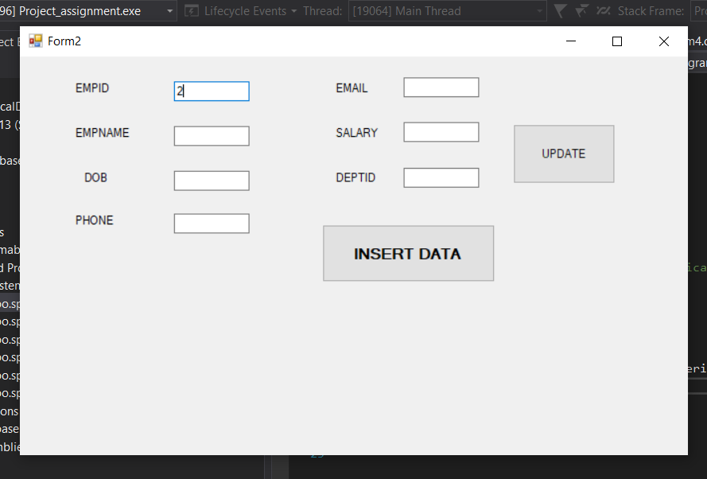
After checking id all fields will be enable

Slide 27
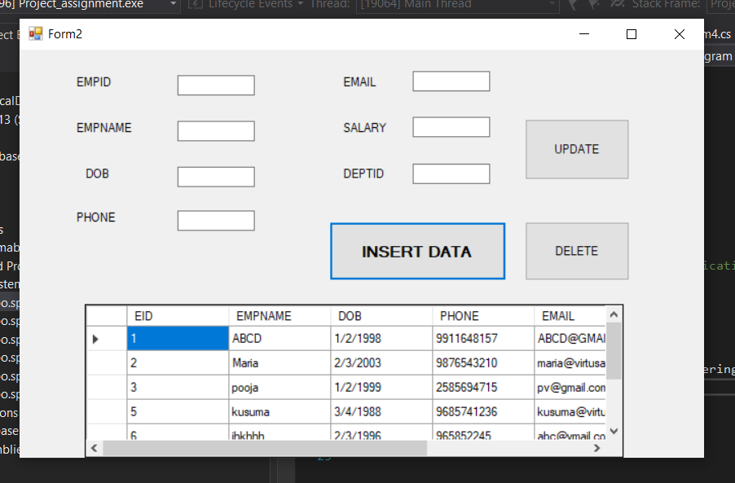
Delete from table
After Inserting data three options will be available
Insert data again
Update a data using id
Delete a record from the given table
Datagrid view.

Slide 28
Delete Procedure
create proc spdeleteemployee
(@EID INT)
AS
BEGIN
DELETE FROM EMPLOYEE WHERE EMPID=@EID;
END

Slide 29
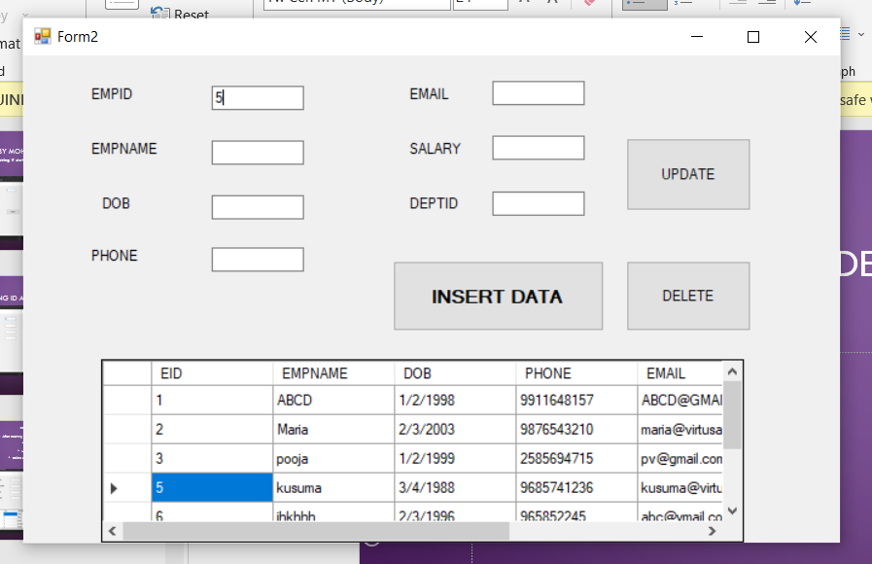
Enter the empid to delete from the given data

Slide 30
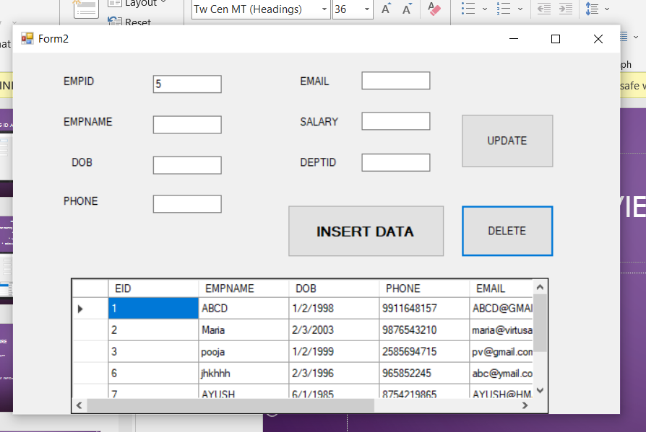
After delete the view of the grid

Slide 31
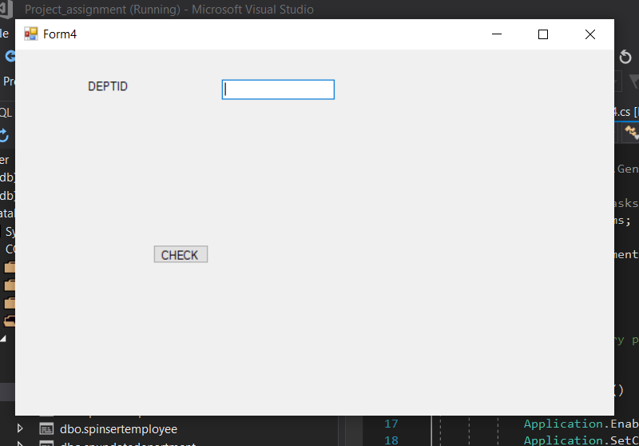
Check button on department table

Slide 32
DELETE FROM DEPARTMENT TABLE
CREATE PROCEDURE spdeletedepartment
(
@DEPTID INT
)
AS
BEGIN
DELETE FROM DEPARTMENT WHERE DEPTID=@DEPTID;
END

Slide 33
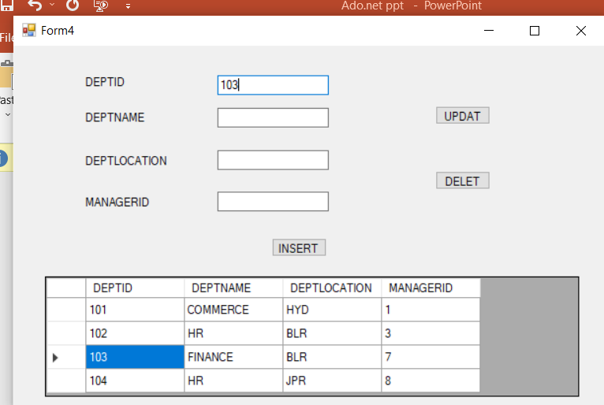
DELETE DATA FROM DEPARTMENT TABLE

Slide 34
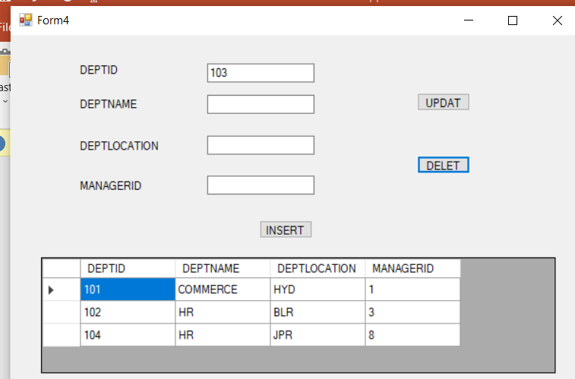
AFTER DELETION

Slide 35
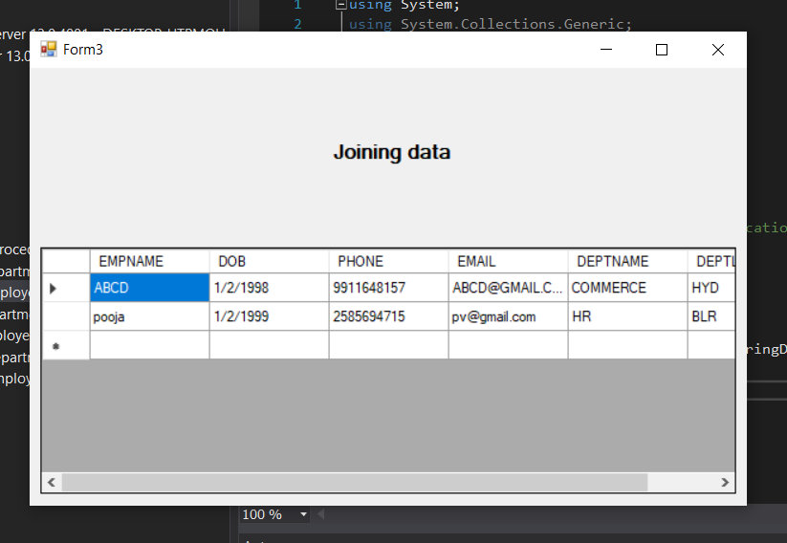
Manager details
By joining two tables we are getting the following data.

Slide 36
Thank you

